Slide 1
*ALE_STRUCTURED_FSI

Slide 2
Motivation
Problems with *CONSTRAINED_LAGRANGE_IN_SOLID
Leakage Control not robust; exhaustive and unpredictable parameter tuning; no guarantee on effectiveness
One keyword; three totally different functions: . (31/36/38 parameters with 22 pages in Users’ Manual.)
Rebar-Concrete Constraint
Penalty Coupling (mostly used)
Porous Coupling
Messy format; useless options; obsolete features ➔ user confusion ➔ setup mistakes, erroneous results ➔ frustrated users ➔ less and less usage

Slide 3
*ALE_STRUCTURED_FSI
A new member in the “*ALE_STRUCTURED_” family:
*ALE_STRUCTURED_FSI
SLAVE | MASTER | SSTYP | MSTYP |  |  |  | MCOUP
 |  | PFAC |  |  | IFLIP
SLAVE: Structure PART/PARTSET/SEGSET ID
MASTER: ALE mesh PART ID
SSTYP: PARTSET/PART/SEGSET (0/1/2)
MSTYP: PARTSET/PART (0/1)
MCOUP: ALE fluids to be coupled
PFAC: Penalty formulation & Stiffness
= 0.? m/dt^2
=-N: Load Curve (recommended)
FLIP: Flip structure normal or not
New card in the Structured ALE solver.
*ALE_STRUCTURED_MESH
*ALE_STRUCTURED_MESH_TRIM
*ALE_STRUCTURED_MESH_MOTION
*ALE_STRUCTURED_MESH_VOLUME_FILLING
*ALE_STRUCTURED_FSI

Slide 4
Smooth Transition
Minimized work to convert old input containing *CONSTRAINED_LAG_IN_SOLID cards. One parameter change: CTYPE=4 ➔ CTYPE=104.
Automatically convert CLIS cards to *ALE_STRUCTURED_FSI. Store the converted file, print warning message and continue the run.
Limited release to certain users. Testing and feedback.
Only works for S-ALE for now as ALE searching/sorting algorithm must be efficient; still under development.
As a temporary solution, CTYPE=104 triggers the solver to convert ALE model to S-ALE model.

Slide 5
Enhanced Algorithm
Penalty formulation. Penalty spring is attached between pairs (fluid/structure) of coupling points.
For each structure segment, coupling points are not only generated inside each structure segment, but also at edges and nodes.
New algorithm to accurately determine the ALE fluid interface.
New Leakage detection and control algorithm – automated and stable.
New coding: 2159 lines; big reduction to *CONSTR_LAG_IN_SOLID’s ~40k lines
New MPP: utilize the same idea as “Groupable Contact”; big savings for problems with multiple coupling cards.

Slide 6
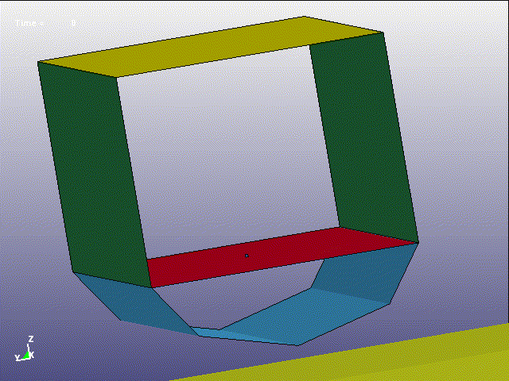
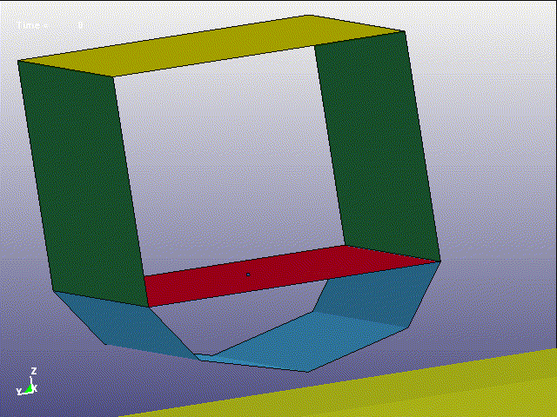

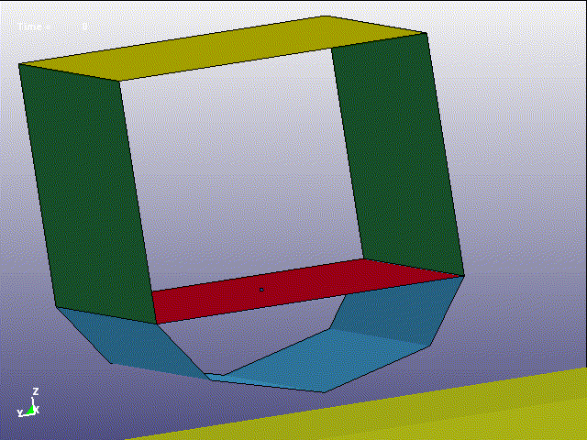
Leakage – Tardec Generic Hull under Mine Blast
*CONSTRAINED_LAGRANGE_IN_SOLID
*ALE_STRUCTURED_FSI
200k shells, 5.5 million ALE elements

Slide 7
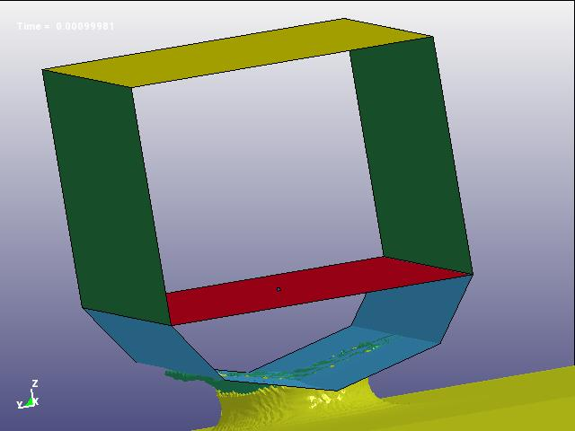
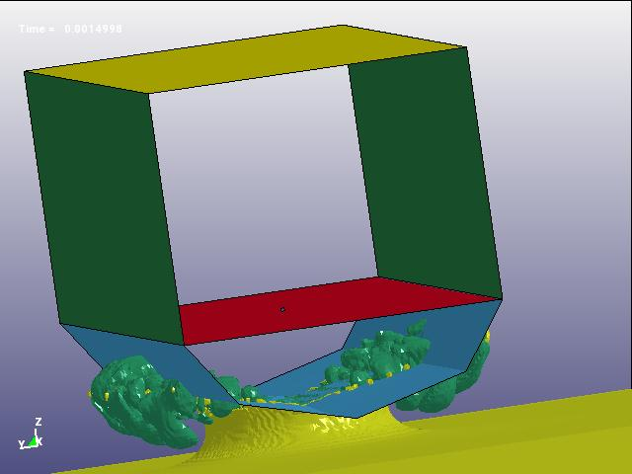
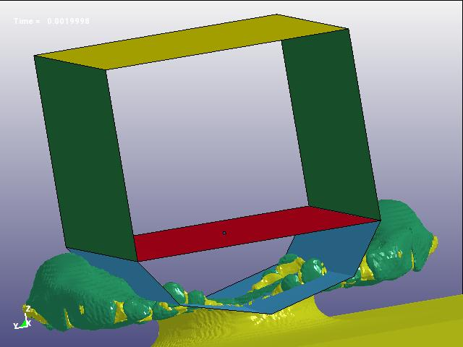
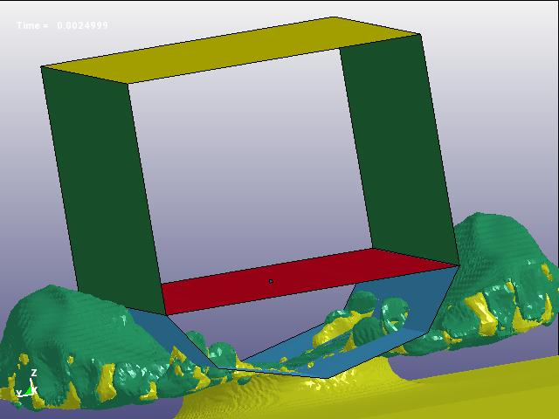
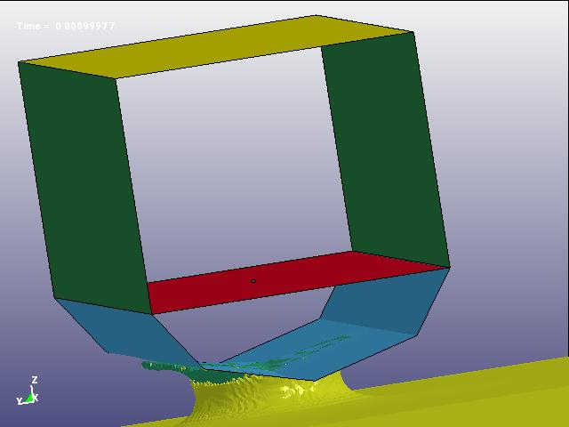
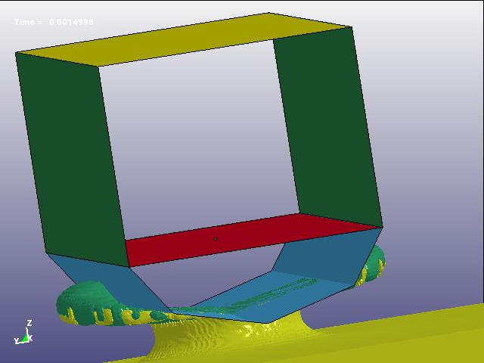
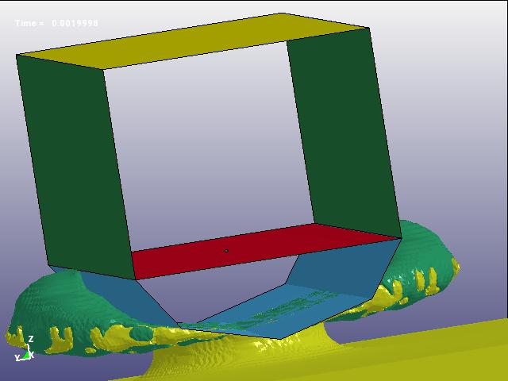
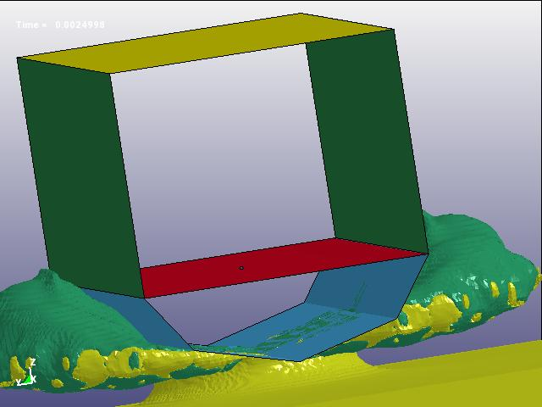
Leakage – CLIS vs. ALE_STRUCTURED_FSI
Runs with *CONSTRAINED_LAGRANGE_IN_SOLID has a “mysterious” leakage at a flat surface.
*ALE_STRUCTURED_FSI successfully detected and controlled leakage.

Slide 8
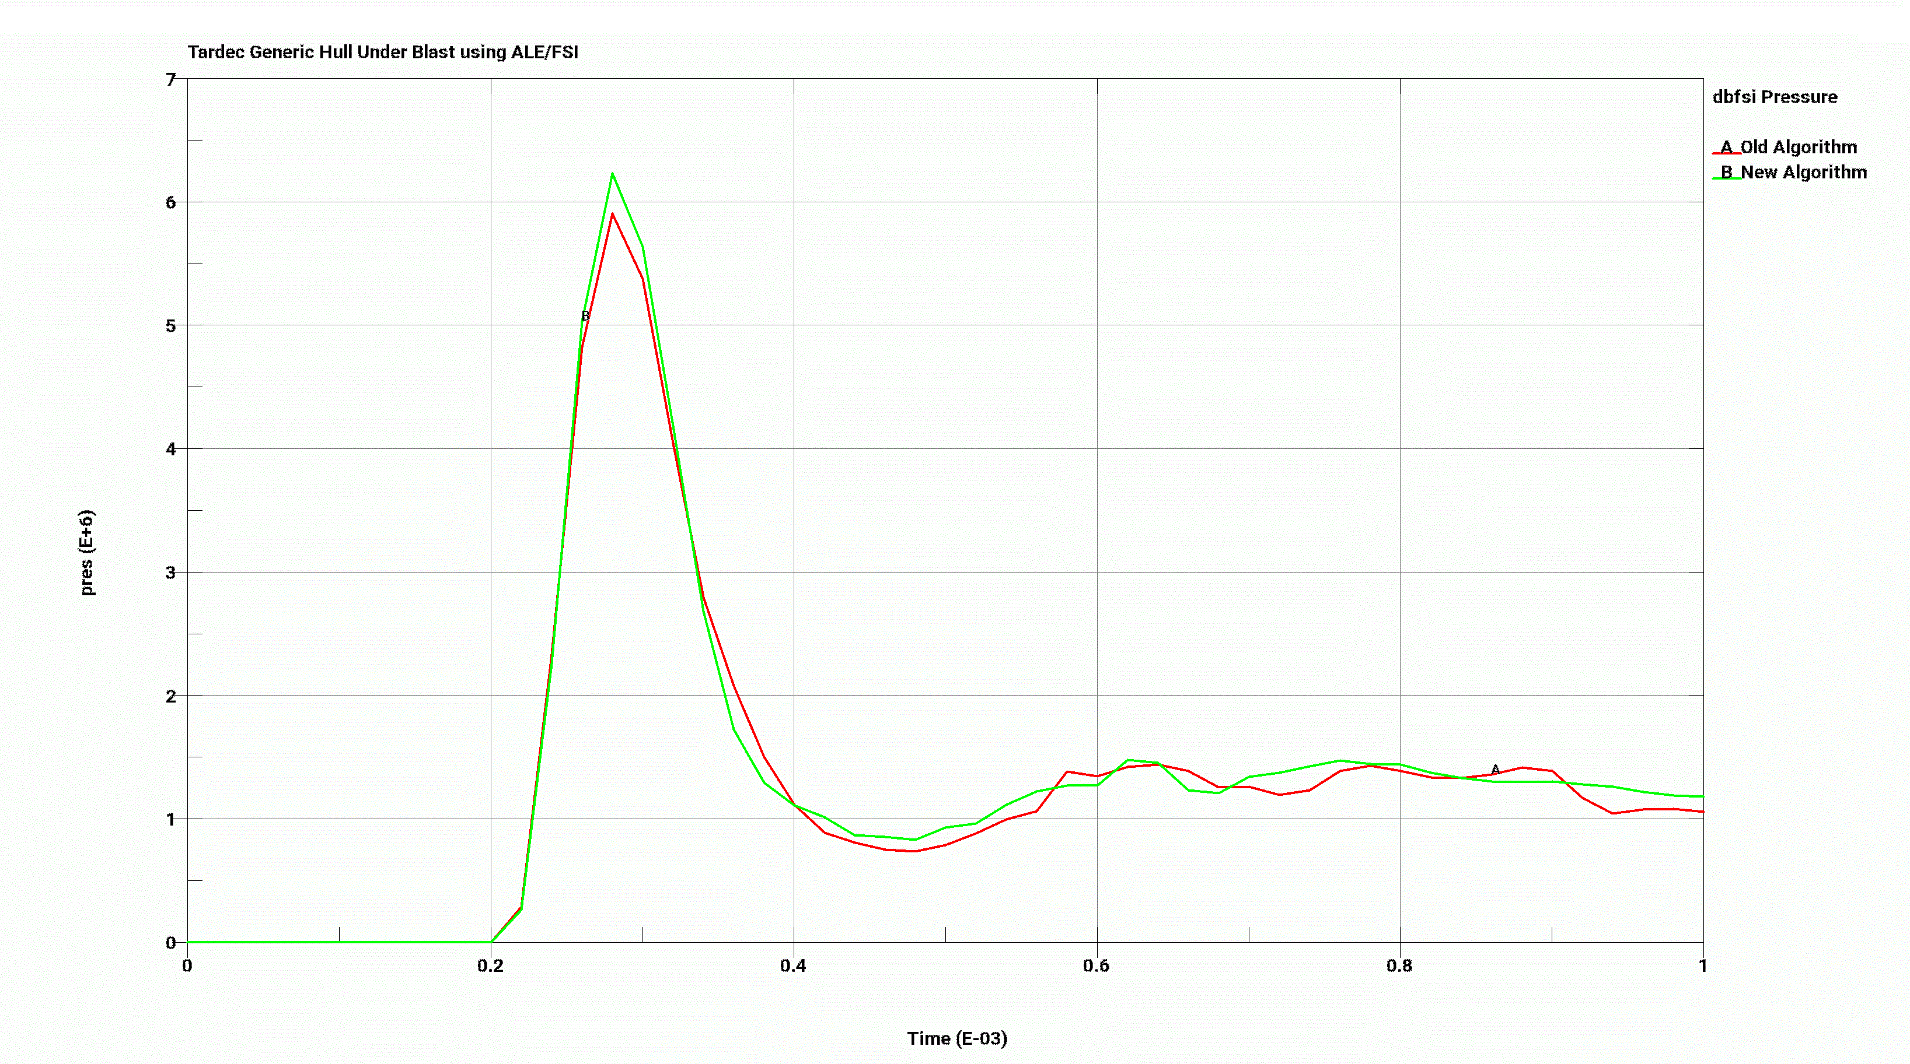
Results – Tardec Model
Less leakage with *ALE_STRUCTURED_FSI gave a larger peak pressure. Note: running time longer due to a smaller timestep.

Slide 9
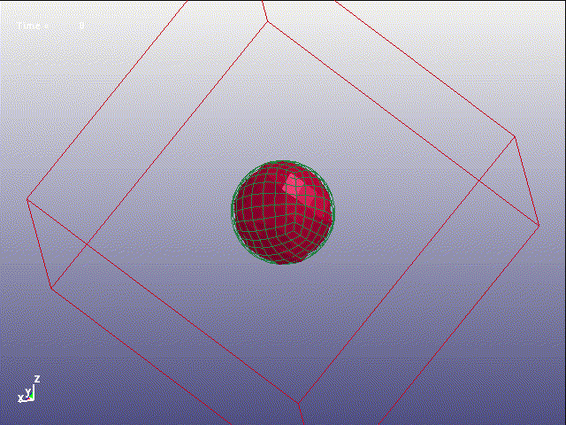
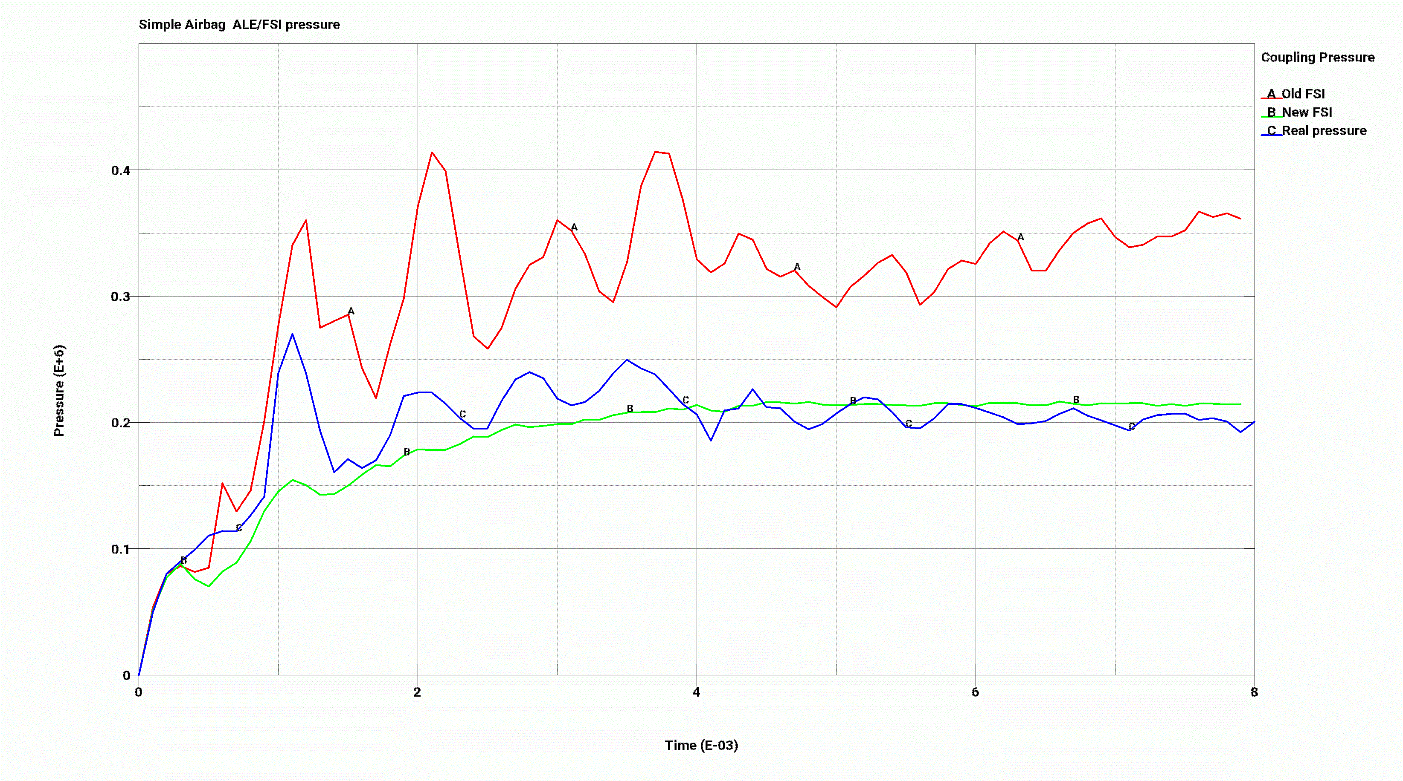
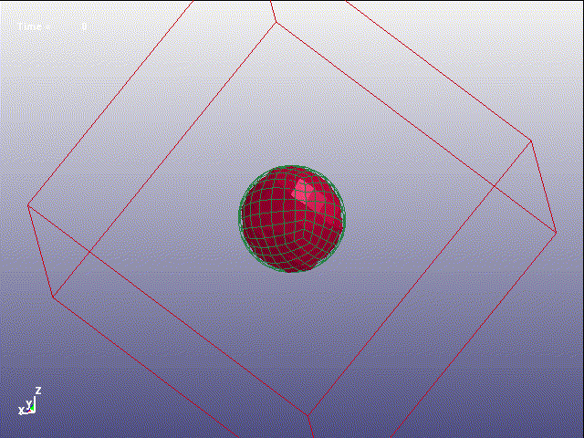
Leakage – Simple Airbag
Pressurized air is light. It moves fast and tends to leakage. This simple spherical airbag has been used to test leakage detection and control algorithms.
294 shells and 9261 ALE elements.
Both CLIS and ASF passed this test.
However, *ALE_STRUCTURED_FSI captured the right coupling pressure while *CONSTRAINED_LAGRANGE_IN_SOLID’s result is much higher.

Slide 10
MPP Implementation
“GROUPABLE” approach: MPP communications are done for multiple coupling cards at once. Not done for each coupling card separately.
MPP communications are separated into MPI_IRECV() and MPI_ISEND() and placed strategically between major CPU hotspots (such as element subroutines, contact subroutines). This greatly reduced, if not eliminated the message passing time.
One code for SMP/MPP. This greatly reduced code length and un-needed effort to maintain two sets of code.
Will add SMP soon to support MPP hybrid.

Slide 11
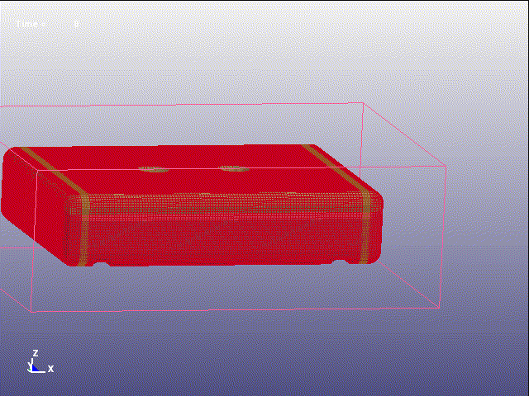

“GROUPABLE” MPP for Multiple Coupling Cards
Fuel tank, using 3 coupling cards, coupled to a) inside fuel, b) inside vapor and c) outside air (not shown); 41k shells and 91k ALE elements; run with 48 cores.

Slide 12
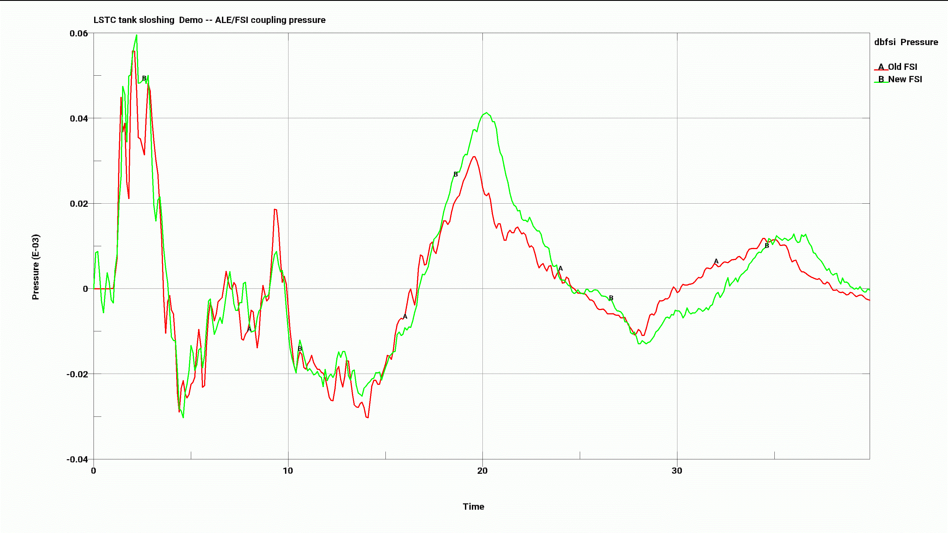
Time Saving with Multiple Couplings
*ALE_STRUCTURED_FSI | *CONSTRAINED_LAGRANGE_IN_SOLID
S-ALE FSI ............ 5.1793E+02 S-ALE FSI ID 1 .. 4.5567E+01 S-ALE FSI ID 2 .. 8.0366E+00 S-ALE FSI ID 3 .. 4.4024E+01 S-ALE Advection ...... 2.0511E+02 | ALE FSI Algorithm .... 1.8111E+03 FSI ID 1 ... 7.2176E+02 FSI ID 2 ... 4.7892E+02 FSI ID 3 ... 6.1037E+02 S-ALE Advection ...... 1.7736E+02
1188 seconds for 37865 cycles | 2558 seconds for 37523 cycles
CLIS and ASF yield similar FSI pressure. With 3 cards, ASF only used 29% of time CLIS used.
mppdyna single precision dev.139039 48 core on barstow

